Slide 1
Presentation #1
By Hanning Zhou and Isabella Latcham-Radusky

Slide 2
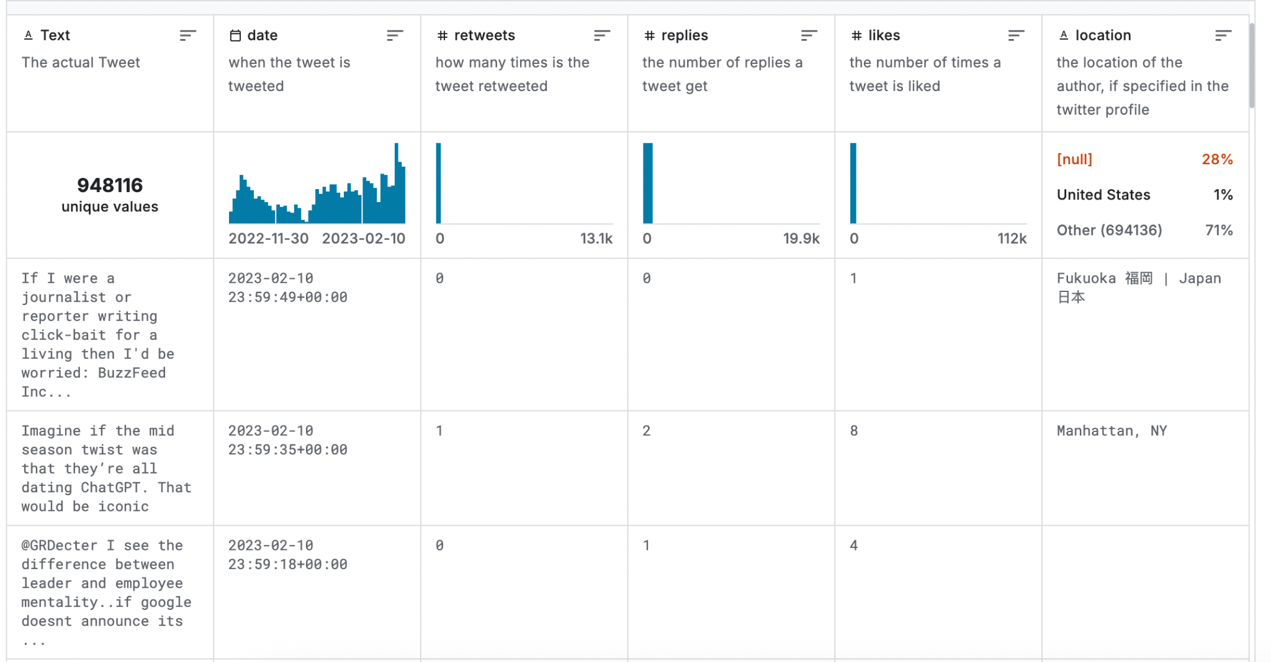
What is the data?
Contains tweets discussing ChatGPT in its initial public launch
Collected from November 30, 2022 to February 11, 2023
Includes information about date, interaction, followers, and location
Notes:
This dataset contains tweets discussing ChatGPT in its initial public launch. These tweets were collected from November 30 2022 to February 11 2023 which is the period directly following ChatGPT’s release to the public. The dataset includes information about the date when this was tweeted. Also how popular the tweet was meaning how many people retweeted it, how many replies it got, as well as likes. The location was included giving us information about the entire world’s reaction to ChatGPT. It also includes information about the accounts so how many followers they have, and how many people they were following.

Slide 3
Why do we find it interesting?
AI is impacting the world greatly and we want to see how people feel about this
The relationship between humans and technology
It feels especially relevant to us as we are entering the job market
Everyone has a different perspective on these new technologies
Notes:
Hanning: As a former law student, during my early internships, I often had to do a lot of mundane tasks, such as organizing documents and correcting minor mistakes made by senior lawyers. These tasks were mundane, and while artificial intelligence could easily handle them, it was precisely because of these tasks that senior lawyers were forced to hire low-cost student interns, providing us with a glimpse into the legal profession. However, with the help of artificial intelligence, senior lawyers no longer need to hire student interns to perform these tasks. On the one hand, this is good because students don’t waste time; but on the other hand, students have fewer opportunities to get internships and jobs, and we can’t train for those jobs, and we lose the opportunity to build connections with large law firms during our internships.I believe every social scientist should consider the relationship between artificial intelligence and the job market, as well as the public's general perception of this. Artificial intelligence is reshaping the world, not only in our daily lives but also in the job market. This means everyone faces challenges similar to those faced by manual laborers during the Industrial Revolution. Students, whether in the humanities, social sciences, or natural sciences, should address the question: What do we need to do in this evolving world of artificial intelligence? No one wants to be left behind and become a victim of this high-tech world. Therefore, we ourselves must contribute. Furthermore, the development of artificial intelligence should also address this question. Tools are tools, but guiding their development is the responsibility of designers.
Isabella: I am curious about the impact of AI and humans perception of it. Now being in this program I have been confronted with different people’s opinions about AI and it was actually very shocking. I kind of thought we were all on the same page here and I have quickly realized that we are not. Even in our initial combing through of the dataset it has been made abundantly clear that people have many different ideas about AI and where it is going. I think this dataset it super interesting because we get to see peoples initial thoughts about AI and note if it changed in the initial months of its launch as they actually began to see it in use.

Slide 4
What questions we want to ask?
How did people’s reaction change throughout its initial launch?
Does location affect people’s opinion towards AI?
We noticed something odd with the dates, and we want to find out why there was a decline during the new year.

Slide 5
Thank you for listening

